Slide 1

Welcome to HOMEroom
Frenship High School
Wolfforth TX

Slide 2
Dr. Anthony Muhammad‏@newfrontier21·
Question of the day: What are we doing to improve the lives (not test scores) of children?

Slide 3
The “Blue Print”
Homerooms will meet weekly. (Tuesdays)
Each teacher will have a HOMEroom class and will keep that class for the entire year.
Classes will have only one grade level and will match the grade level that teacher teaches as much as possible.
Class size is about 17
Attendance submitted electronically.

Slide 4

Making It Fit – The Schedule
Frenship High School Bell Schedule 2014-2015
Monday |  |  | Tuesday |  |  | Wednesday/Thursday/Friday
8:00 - 8:49 | Strategy Sessions/MMA |  | 8:00 - 8:24 | Activity Period |  | 8:00 - 8:24 | Activity Period
8:49 - 8:55 | Passing Period |  | 8:24 - 8:30 | Passing Period |  | 8:24 - 8:30 | Passing Period
8:55 - 10:21 | 1st/5th Period |  | 8:30 - 9:46 | 1st/5th Period |  | 8:30 - 10:06 | 1st/5th Period
10:21 - 10:27 | Passing Period |  | 9:46 - 9:52 | Passing Period |  | 10:06 - 10:12 | Passing Period
10:27 - 11:48 | 2nd/6th Period |  | 9:52 - 11:13 | 2nd/6th Period |  | 10:12 - 11:48 | 2nd/6th Period
11:48 - 11:54 | Passing Period |  | 11:13 - 11:19 | Passing Period |  | 11:48 -11:54 | Passing Period
11:54 - 1:54 | 3rd/7th Period |  | 11:19 - 11:48 | Homeroom |  | 11:54 - 1:54 | 3rd/7th Period
11:54 - 12:19 | A Lunch - 12:24 tardy |  | 11:48 - 11:54 | Passing Period |  | 11:54 - 12:19 | A Lunch - 12:24 tardy
12:24 - 12:49 | B Lunch - 12:54 tardy |  | 11:54 - 1:54 | 3rd/7th Period |  | 12:24 - 12:49 | B Lunch - 12:54 tardy
12:54 - 1:19 | C Lunch - 1:24 tardy |  | 11:54 - 12:19 | A Lunch - 12:24 tardy |  | 12:54 - 1:19 | C Lunch - 1:24 tardy
1:24 - 1:54 | D Lunch - 2:00 tardy |  | 12:24 - 12:49 | B Lunch - 12:54 tardy |  | 1:24 - 1:54 | D Lunch - 2:00 tardy
1:54 - 2:00 | Passing Period |  | 12:54 - 1:19 | C Lunch - 1:24 tardy |  | 1:54 - 2:00 | Passing Period
2:00 - 3:30 | 4th/8th Period |  | 1:24 - 1:54 | D Lunch - 2:00 tardy |  | 2:00 - 3:30 | 4th/8th Period
 |  |  | 1:54 - 2:00 | Passing Period
 |  |  | 2:00 - 3:30 | 4th/8th Period
Lunches- Assigned to 3rd/7th period teachers |  |  |  |  |  | Activity Period (AP)
 | A Lunch |  |  | C Lunch |  | Tues - Friday | 8:00 - 8:24 AM
11:54 - 12:24 | Lunch |  | 11:54 - 12:54 | 3rd/7th Period
12:24 - 1:54 | 3rd/7th Period |  | 12:54 - 1:24 | Lunch
 |  |  | 1:24 - 1:54 | 3rd/7th Period
 | B Lunch
11:54 - 12:24 | 3rd/7th Period |  |  | D Lunch
12:24 - 12:54 | Lunch |  | 11:54 - 1:24 | 3rd/7th Period
12:54 - 1:54 | 3rd/7th Period |  | 1:24 - 1:54 | Lunch

Slide 5
The Goals
Increase support of our students, both academically and emotionally.
Build relationships with and among students through a variety of activities including inspirational videos and discussion, ice breaker activities, interest inventories and post-secondary planning.
Motivate and Inspire students and faculty alike.
Develop a service learning component where students become more aware of their societal role on a community, regional and global scale.
Minimize lost instructional time by conducting school wide “housekeeping” activities during homeroom time.

Slide 6
HOMEroom
Freedom Writers – I am home clip
https://www.youtube.com/watch?v=9f8liieRepk

Slide 7

The OPPORTUNITIES

Slide 8

The OPPORTUNITIES
The School House is often the most stable environment for many of our kids.
  We have the opportunity to be the PARENT away from home.
  We have the opportunity to SPEAK VISION into the lives of our kids.
  We have the opportunity to be the ADULT ENCOURAGER in their lives.
  And all that is expected of you is the gift of your
  TIME & ATTENTION.

Slide 9
Housekeeping
Distribute 1st Day Schedules and collect
registration materials
Agenda Books
Class Meetings (Grouping allows for grade specific information)
Safety and Security Information
Counselor Presentations on Course Selection and Graduation Plans
Class Rings, Caps and Gowns, etc.
Voting for Student Council Officers, Homecoming Court, Prom Theme and Royalty

Slide 10
Academic Support
Monitor Academic Progress of Students (progress reports and report cards distributed)
Grade Specific Content
  PSAT,PLAN Results
  Registration/Course Request info
  Scholarship info
  ACT/SAT info

Slide 11
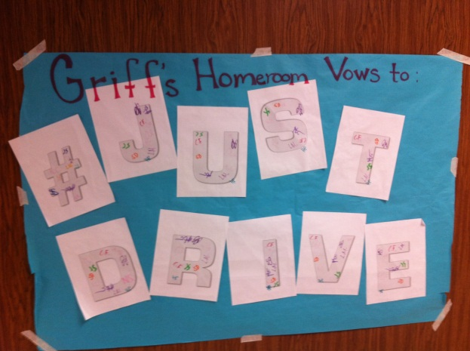

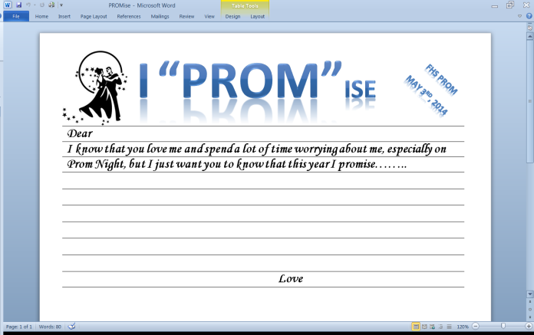
Relationships
Icebreaker Activities
Character Videos
Guided “Lessons” and Discussion
Develop Accountability Groups
  Texting & Driving
  Alex Sheen: because I said iwould.com
  PROMise

Slide 12

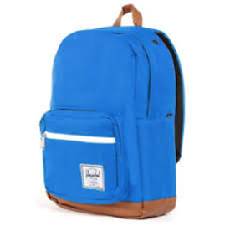

Service Learning
Fund Raising Opportunities
  Pack the Pack
  FHS Hunger Games
  The Walk – Hanson
  Believe: Letters to Santa – Make A Wish/Macy’s
  Driving Hunger Out of Rural Texas
Random Acts of Kindness
  Mums for Life Skills

Slide 13
Building Materials
Social Media
YouTube
Ted Talks
WingClips
Simple Truths
Every Monday Matters
Your Staff

Slide 14
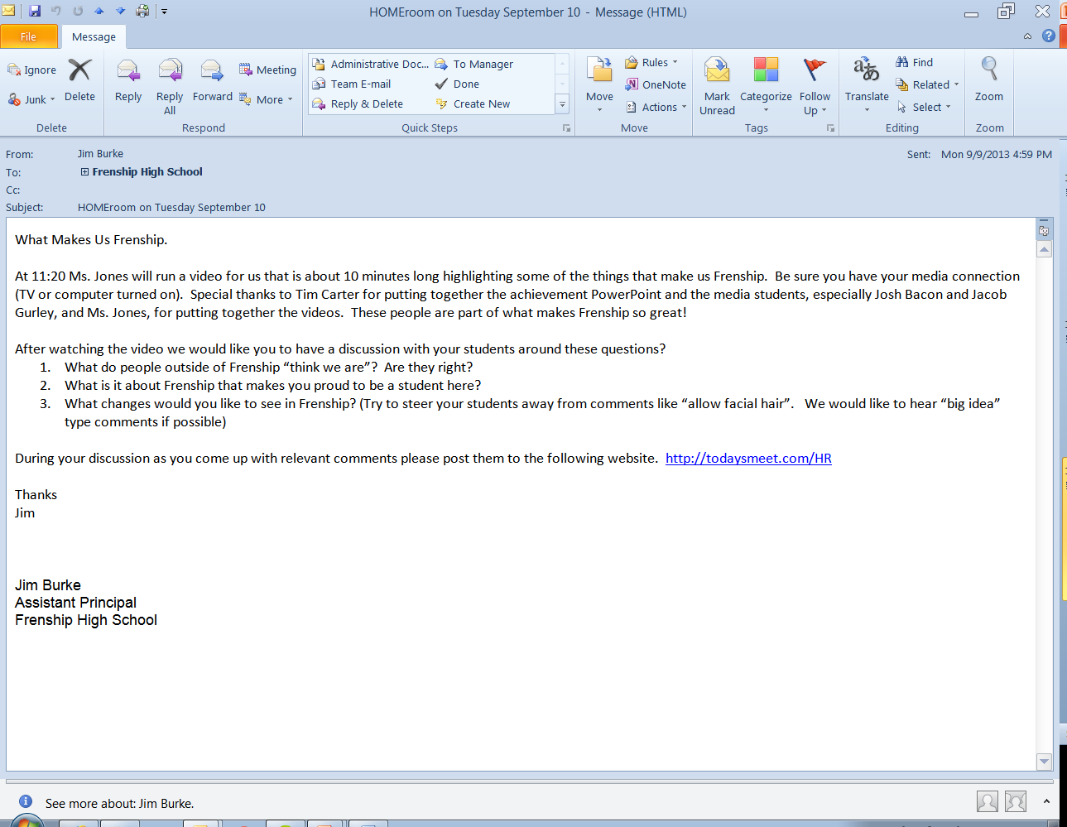
What Makes Us Frenship

Slide 15
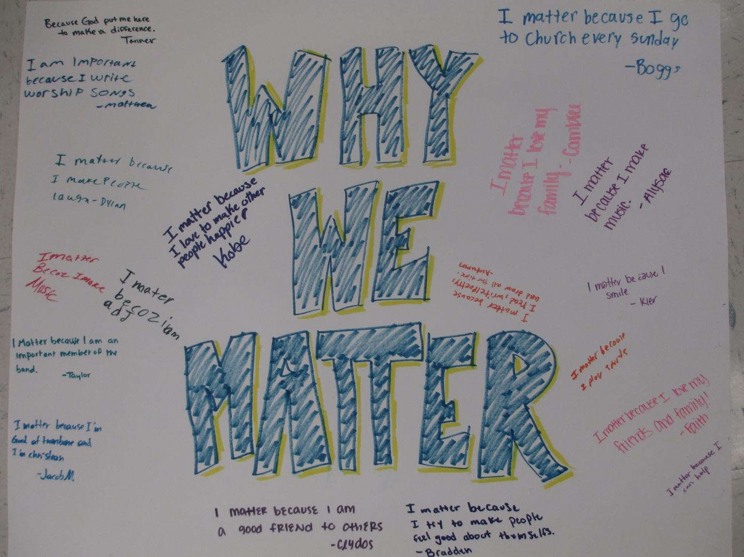
Every Tuesday Matters

Slide 16



Awesomeness
Taking Pleasure In The Small Stuff
The 3 A’s of awesome: Neil Pasricha on TED.com
http://www.ted.com/talks/neil_pasricha_the_3_a_s_of_awesome
http://1000awesomethings.com/

Slide 17
Your One Word
https://www.youtube.com/watch?v=oetiY0EkdQE

Slide 18
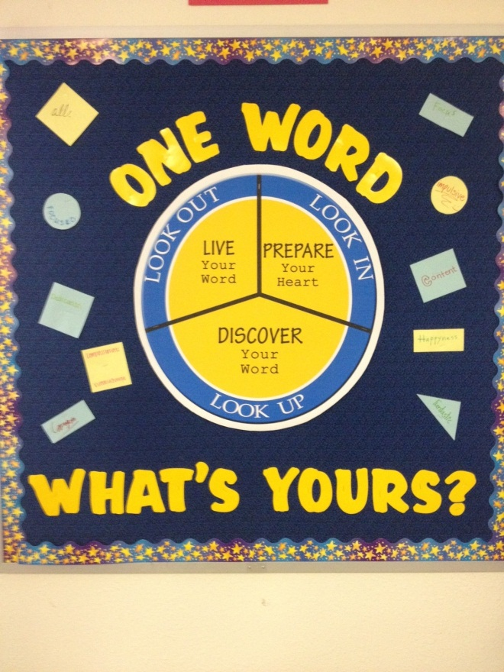
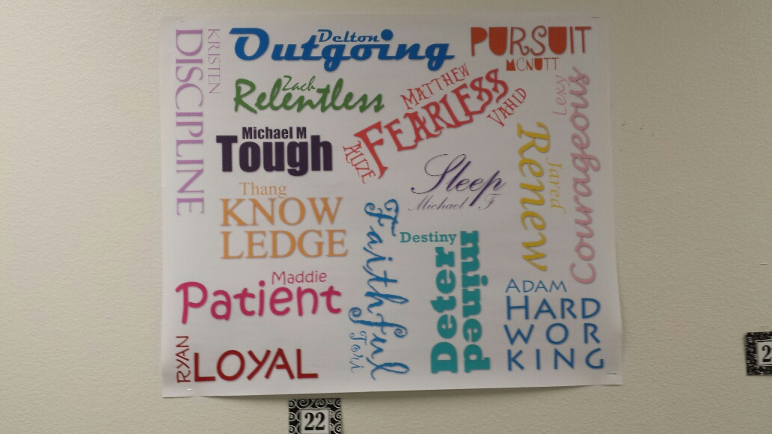
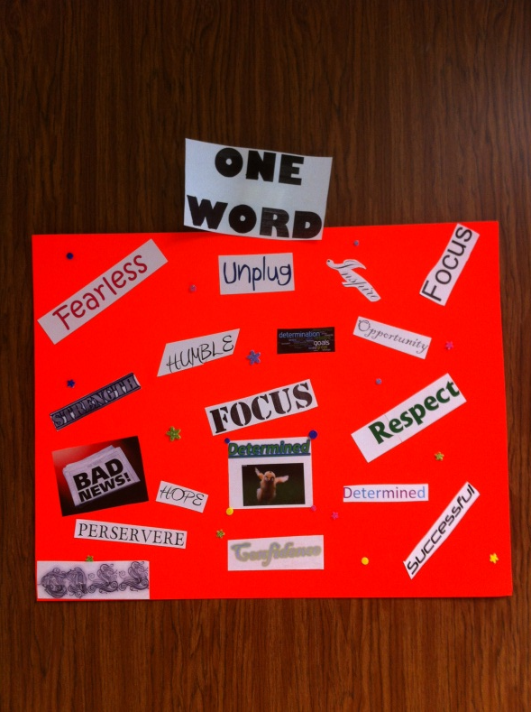

“Your One Word”

Slide 19

Feedback
Keep groups together with same teacher.
Like grade level.
More activities/less discussion.
“Down Time” is great.
“Homey Atmosphere” allowed them to get away from school for a while.
More time at beginning of year for get acquainted activities.
More “non serious” videos/discussion.
Move to Fridays.
Not all teachers as involved.
Longer time period.
Built in homework time.

Slide 20

Moving Forward: 2014-15
“Make Someone’s List”
1.
2.
3.
4.
5.
http://www.stevegilliland.com/video_clips-MADPreview.htm
Time 3:43-11:17

Slide 21

Your Turn
Take 10 minutes and see how many “slots” you can fill in on your list.

Slide 22
Our Challenge To You
Who’s
List
Would
You
Be On?

Slide 23
Contact Info
Frenship High School: www.frenship.us
(806) 866 – 4440
Kim Spicer – Principal: kspicer@frenship.us
Jim Burke – Assistant Principal: jburke@frenship.us

Slide 24
We Are “HAPPY” That You Came to Visit Our HOMEroom.
https://www.youtube.com/watch?v=qB3hZWR0nkk

